Slide 1

HEART ATTACK PREDICTION USING EXPLORATORY DATA ANALYSIS
CSE5007 Exploratory Data Analysis Project
Shruti Khanduja (22MDT0108)
Vinit Bangera (22MDT0097)

Slide 2
METHODOLOGY
Exploratory Data Analysis(EDA)
Descriptive Statistics
Machine Learning

Slide 3
TOOLS
Python
Power BI

Slide 4

Index
Exploratory Data Analysis
Data Description
Determining Categorical and Qualitative data
Summary Statistics
Handling Missing Entries
Outlier Detection
Label Encoding
Univariate Analysis
Bivariate Analysis
Multivariate Analysis
Feature Analysis
Model building

Slide 5
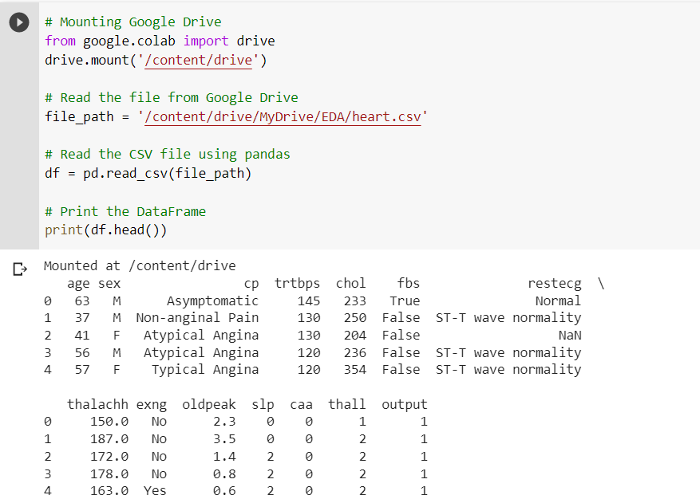

Loading and Reading Data
Dataset source: Heart attack data

Slide 6
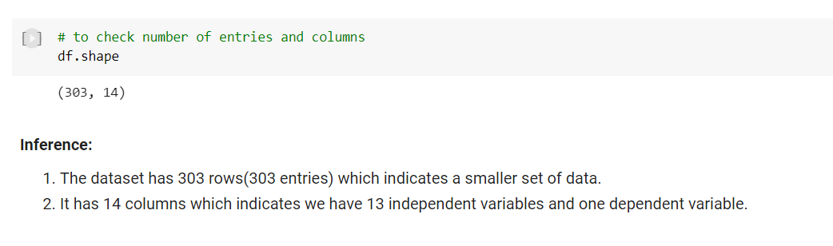
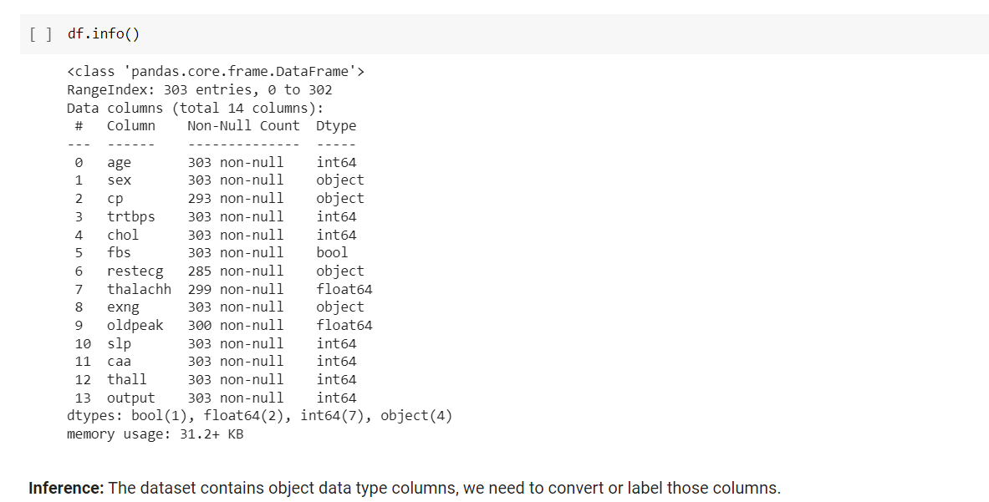


Data Description
Dimension
of Data

Slide 7

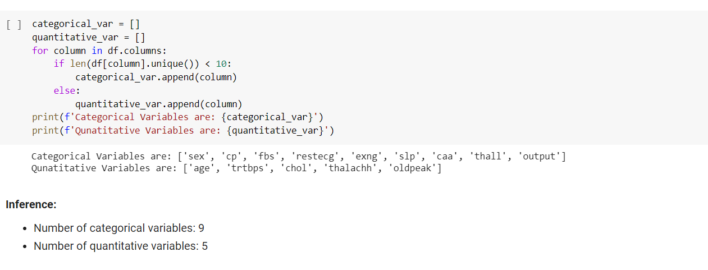
Determining Categorical and Qualitative data

Slide 8
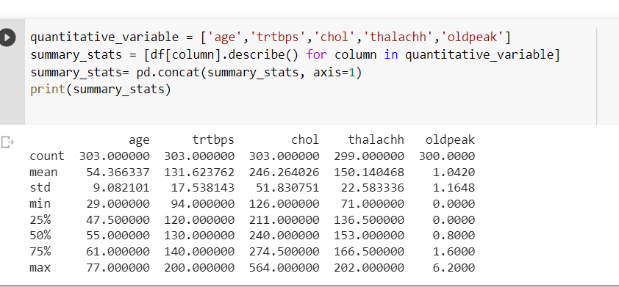

Summary statistics for Quantitative data
Summary statistics refer to a set of numerical measures that provide a concise summary of a dataset's main characteristics. These measures can be used to describe the central tendency, dispersion, and shape of a dataset.

Slide 9
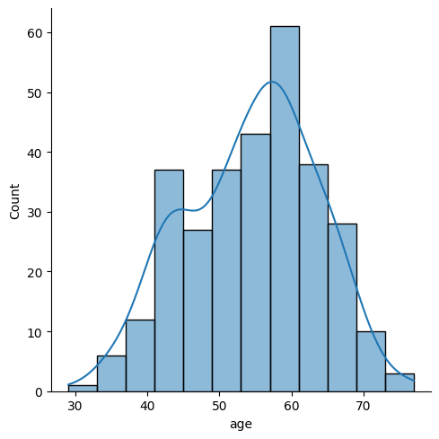
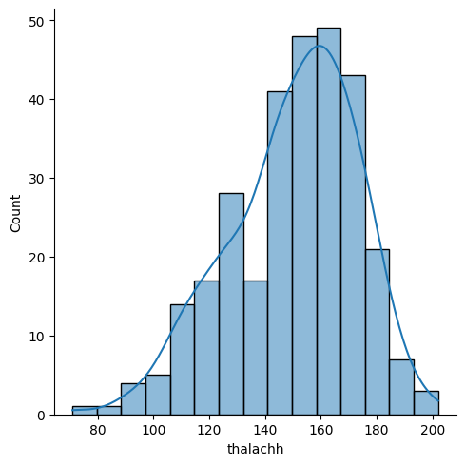
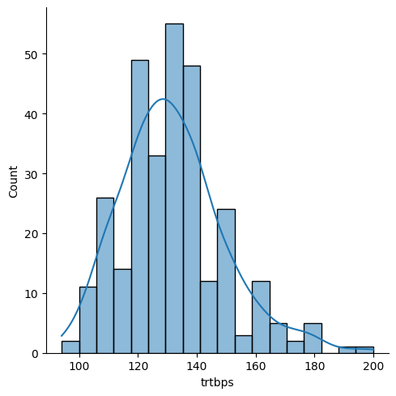
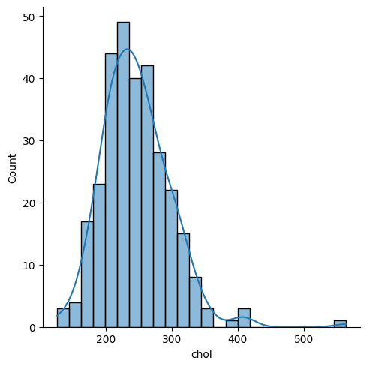
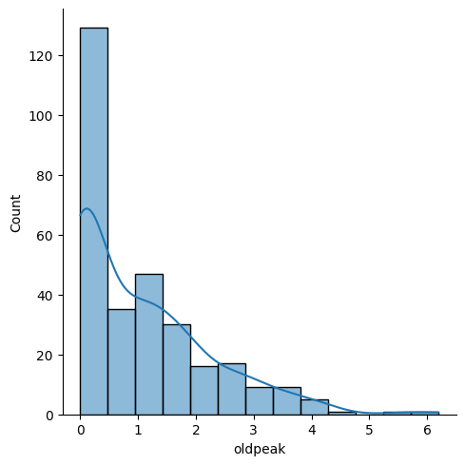
Distribution of Numerical Data
Inference:
age is skewed to the left with a skewness of -0.20
trtbps is skewed to the right with a skewness of 0.71
chol is skewed to the right with a skewness of 1.14
thalachh is skewed to the left with a skewness of -0.54
oldpeak is skewed to the right with a skewness of 1.26

Slide 10
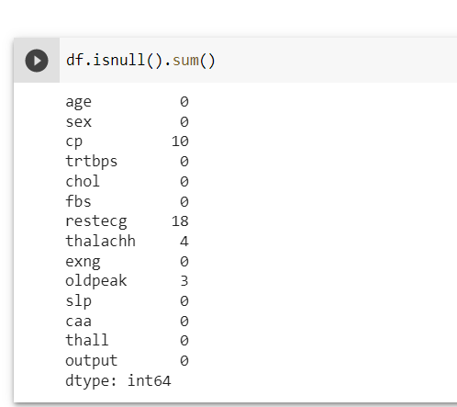

Handling Missing value
Finding Null values

Slide 11
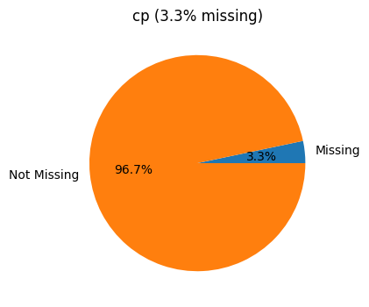
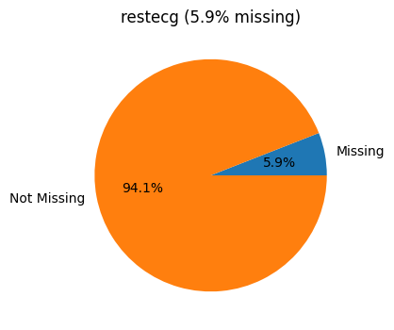
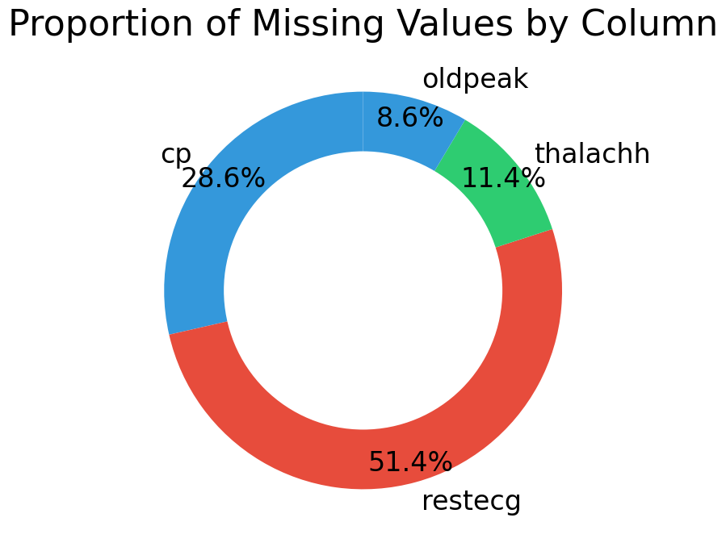
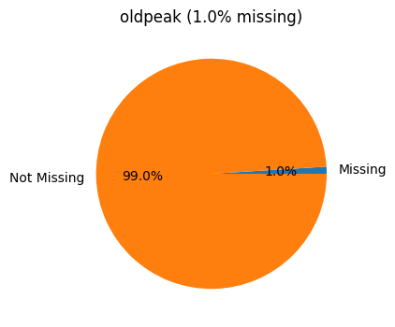
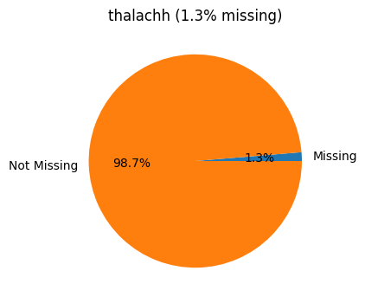
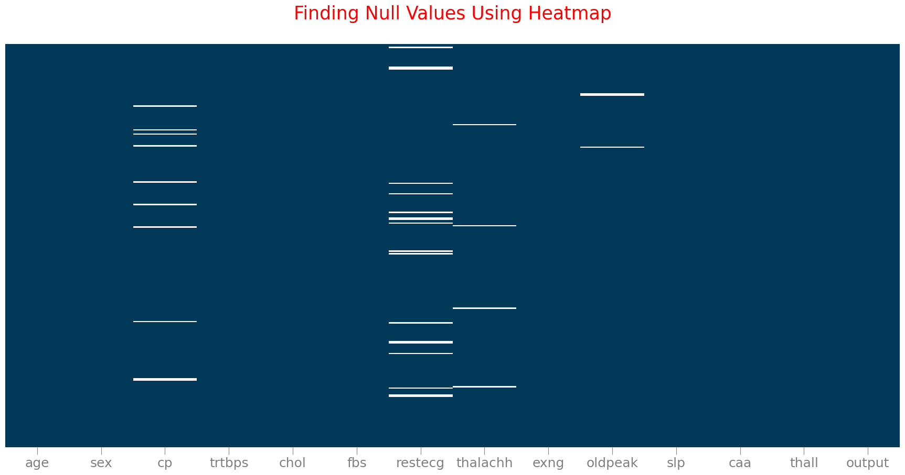
Handling Missing value
Visualizing Null Values

Slide 12
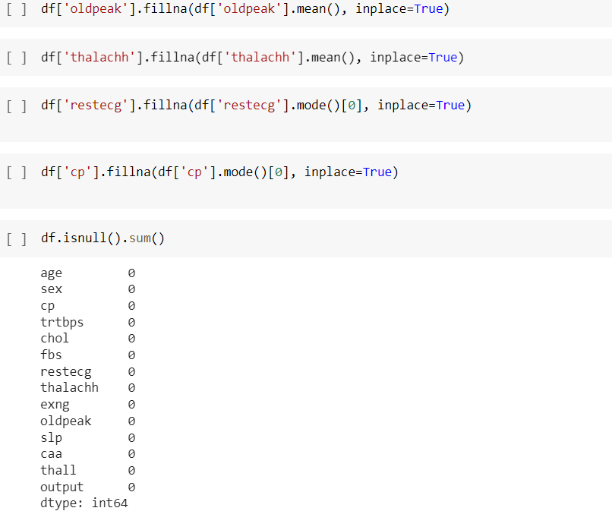
Imputing Missing entries
Imputing quantitative columns with mean
Imputing categorical columns with mode

Slide 13
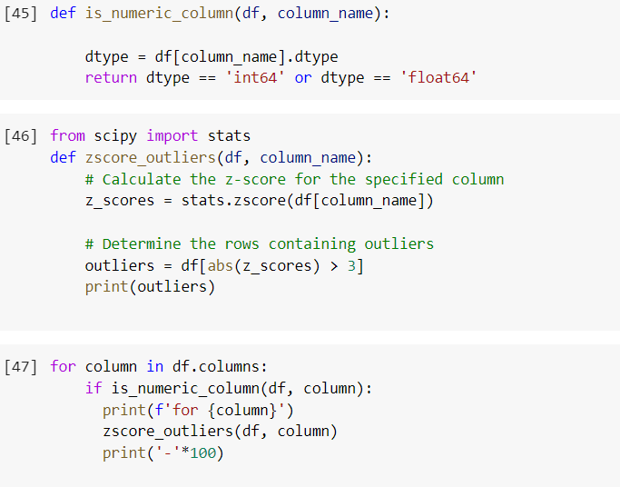
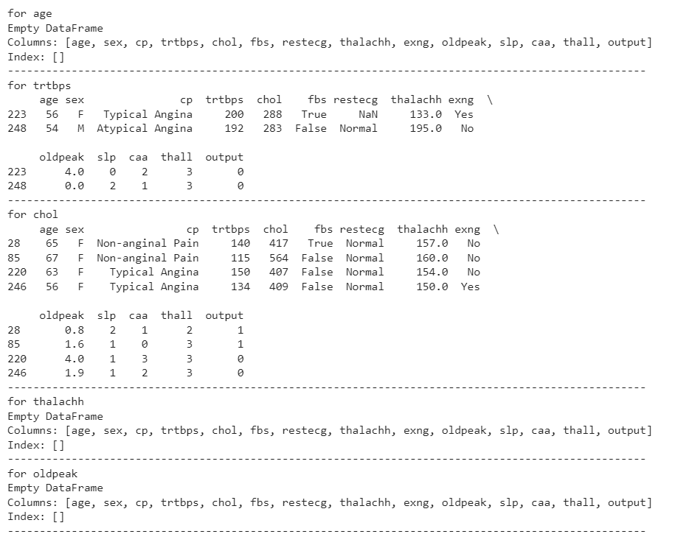
Detecting Outliers
Inference:
Although the above output indicates presence of outliers in the data but since this is a medical data and we know that in medical data, outliers may represent valid and important data points, such as extreme values in patient measurements or rare diseases. Removing these outliers may result in a loss of important information and potentially lead to biased conclusions.
Hence, we are not removing outliers for the given data.

Slide 14
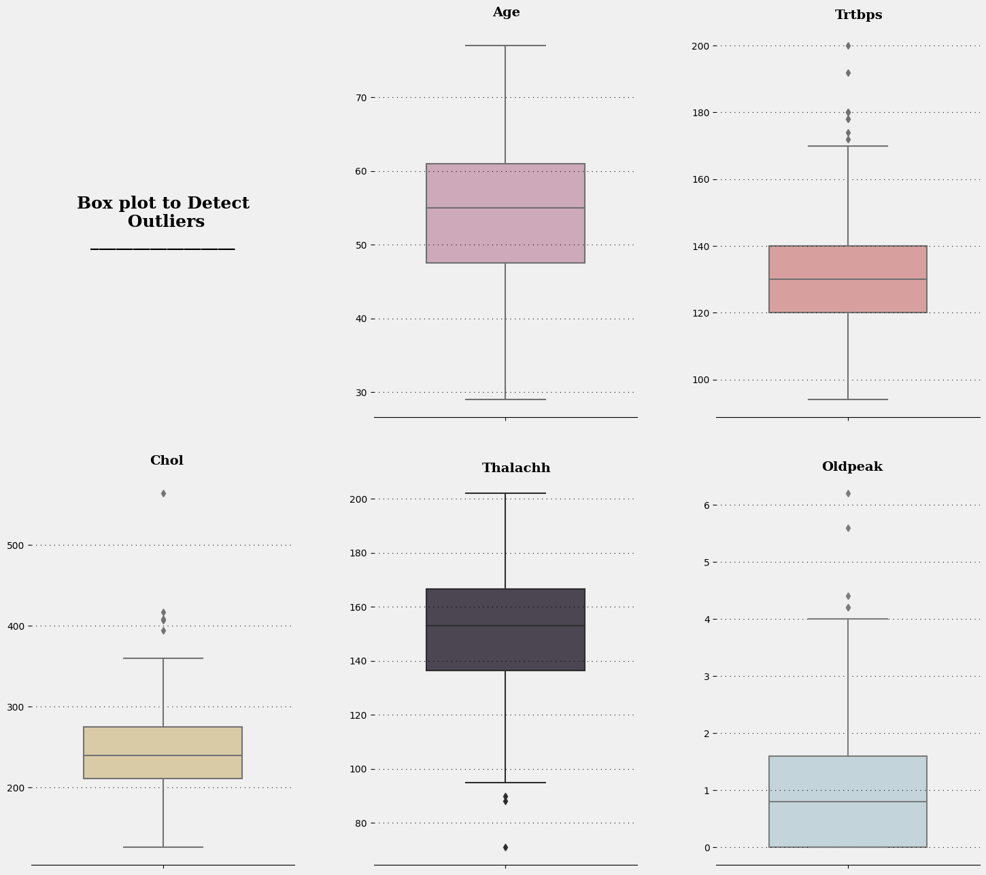
Detecting Outliers
Visualizing Outliers

Slide 15
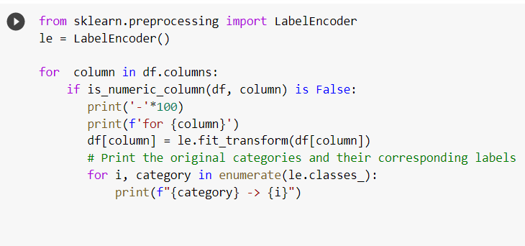
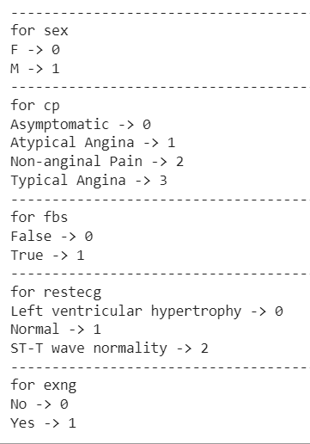
Label ENcODING
Label encoding is a process of converting categorical data (text or labels) into numerical values

Slide 16
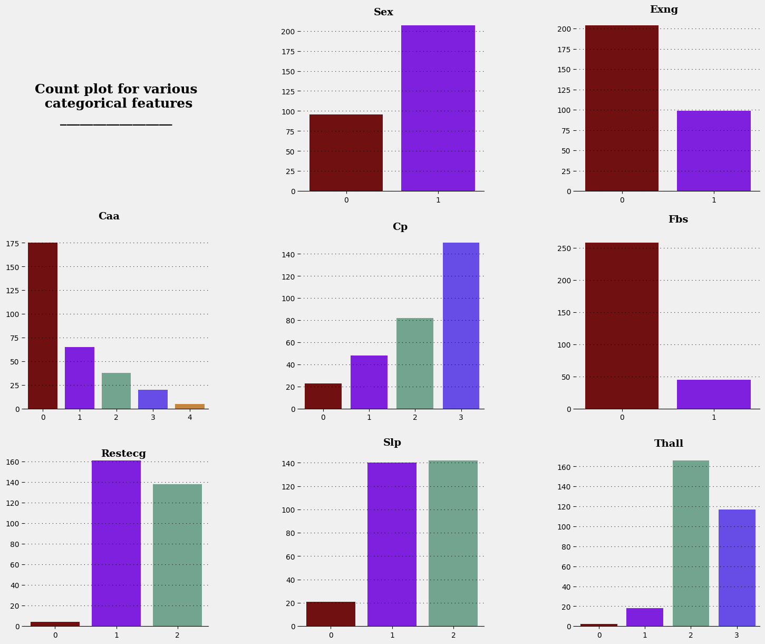
UNIVARIATE ANALYSIS
For
Categorical
Features

Slide 17
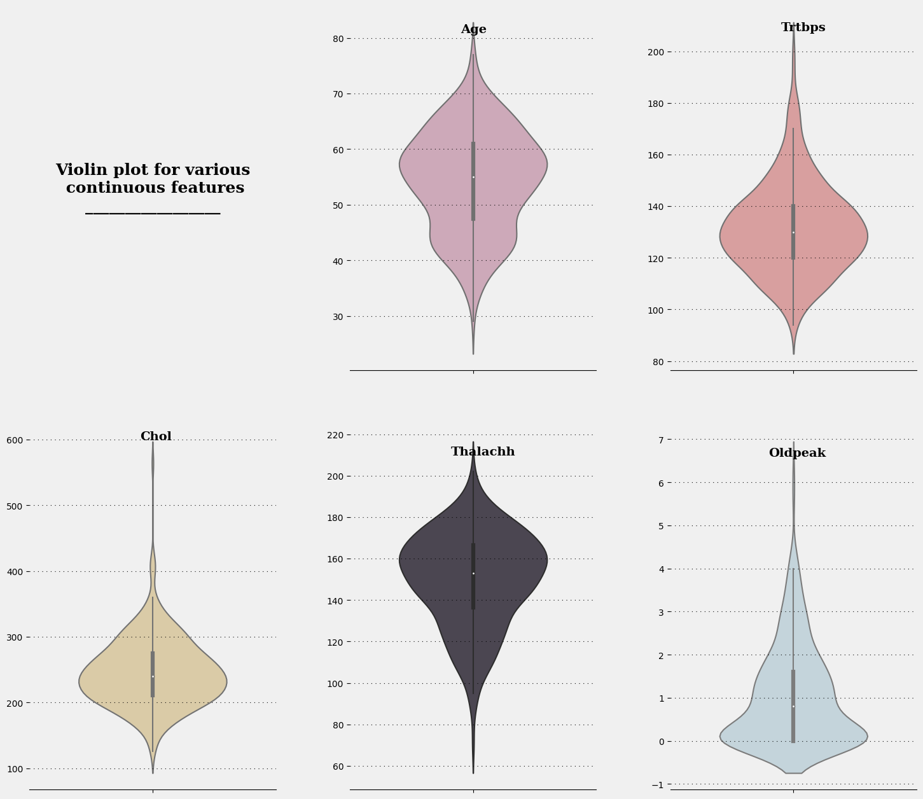
UNIVARIATE ANALYSIS
For
Continuous
Features

Slide 18
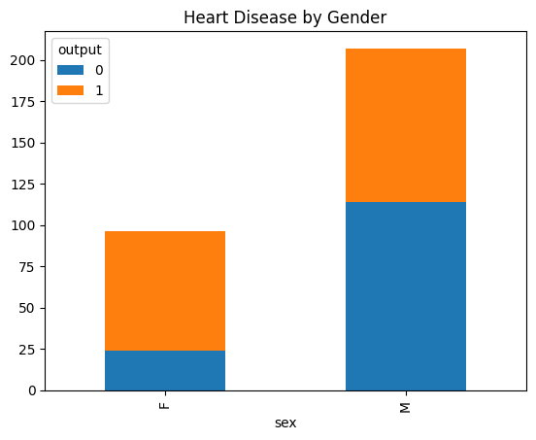
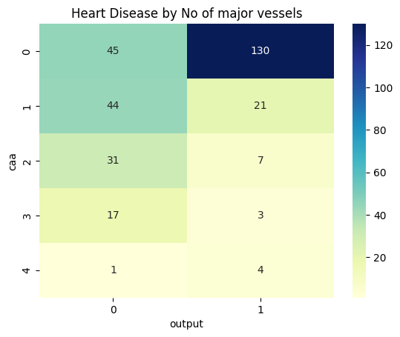
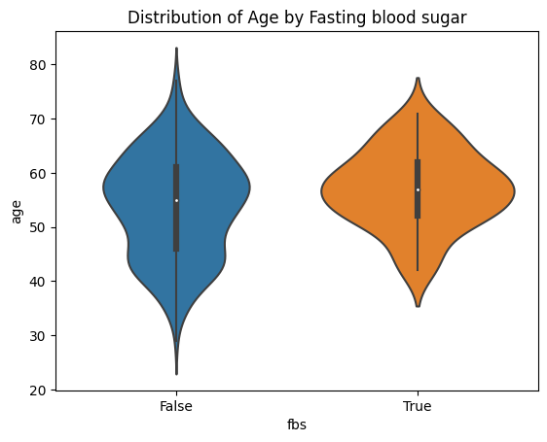
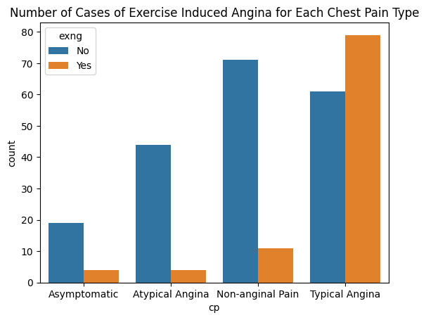
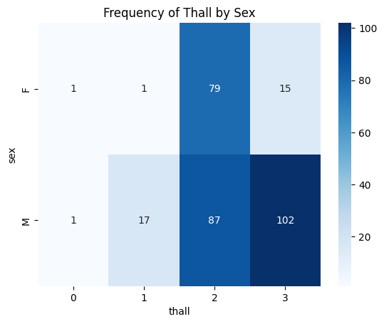
BIVARIATE ANALYSIS
For
Categorical
Features

Slide 19
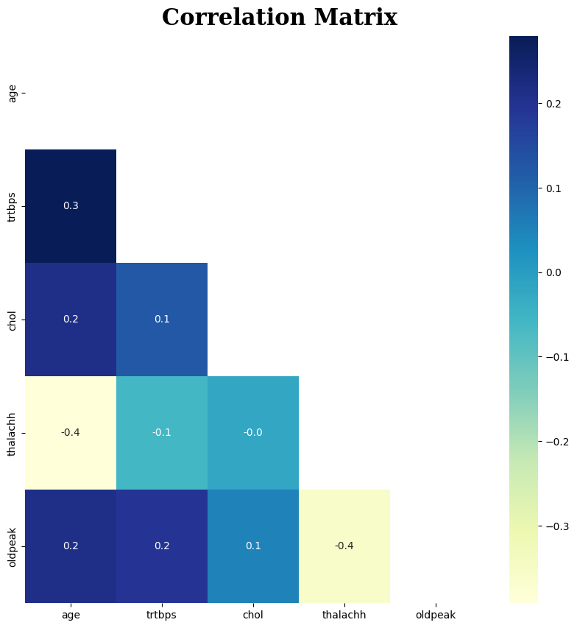
BIVARIATE ANALYSIS
For
Continuous
Features

Slide 20
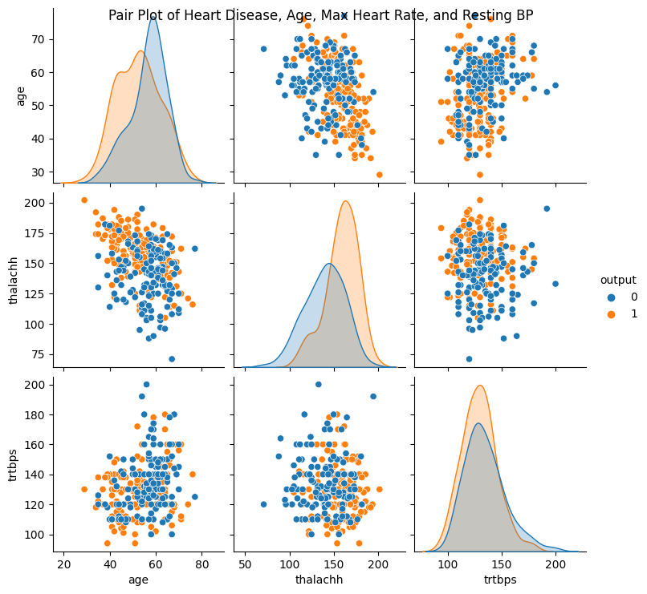
Multivariate ANALYSIS

Slide 21
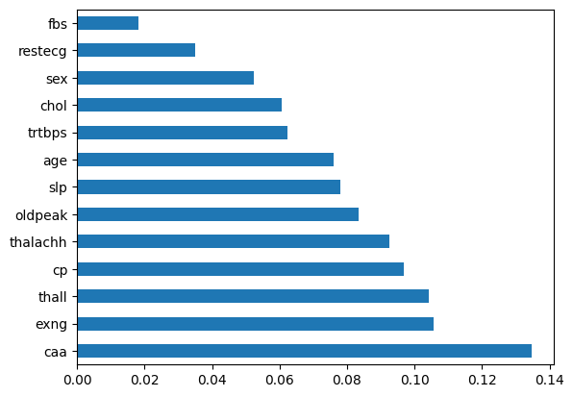
Feature Importance
Inference:
caa (The number of major vessels ) is the most important feature.

Slide 22
Model building
For predicting
Heart attack
Output:
0: Heart attack
1: Normal

Slide 23
Algorithm used
SVM
Decision Tree
SVM is a supervised machine learning algorithm used for classification and regression analysis. It finds the best hyperplane that separates different classes of data points in a way that maximizes the margin between the hyperplane and the nearest data points. SVM is effective in high-dimensional spaces, robust to noise, versatile, and can handle non-linear decision boundaries using different types of kernel functions. Scikit-learn library provides a simple and easy-to-use API for training and testing SVM models in Python.
Decision tree is a supervised machine learning algorithm used for classification and regression analysis. It builds a tree-like model that represents a sequence of decisions and their possible consequences. The algorithm splits the data into subsets based on the most significant attribute at each step and creates a tree of decision nodes and leaf nodes. Decision tree is easy to understand and interpret, can handle both categorical and numerical data, and can handle missing data. Scikit-learn library provides a simple and easy-to-use API for training and testing decision tree models in Python.

Slide 24
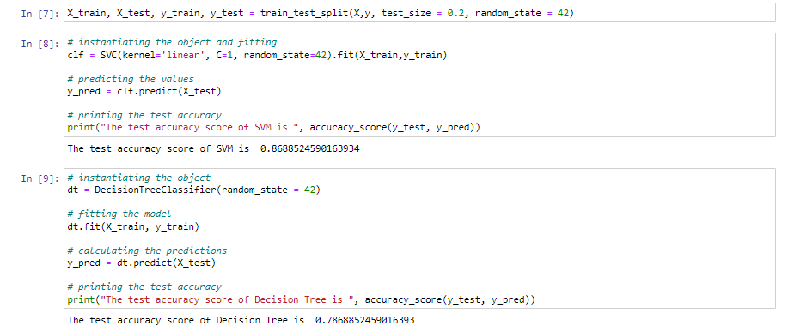
Accuracy of Each Model
Inference:
SVM has better accuracy score.

Slide 25
Thank You

